Slide 1
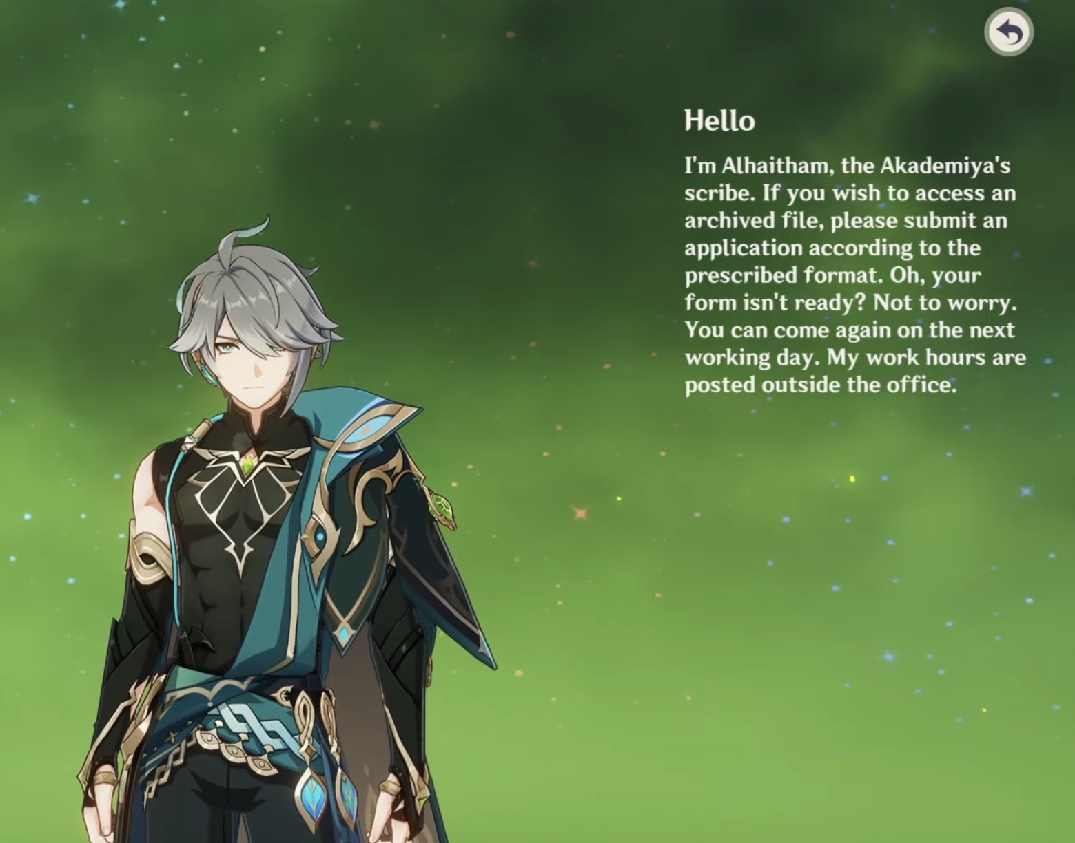
Software Engineering IV
Lecture 37
CS61B, Spring 2024 @ UC Berkeley
Circle Chen

Slide 2

About Myself - Liangyuan (Circle) Chen
I am a junior studying CS and DS.
I’m from Shenzhen, China.
This will be my 6-th time teaching this course (including twice in the summer).
I create and play games, and enjoy listening to game soundtracks.
Itch profile: https://circlecly.itch.io/

Slide 3
Game Development
Game Development
Programmer Perspective
High-level Perspective
Designing Good Game Mechanics
Game Modding
Lecture 37, CS61B, Spring 2024

Slide 4
Indie Game Development
Almost every introductory CS course involves building games.
CS 61A (Hog, Ants)
CS 61B (2048, BYOW)
We do this because games are fun.
What if you liked making games and want to make this a hobby?
Today I’ll go over what indie game development is like.
Indie means “independent”.
Contrast to working at game companies like Riot and Blizzard.
A lot more freedom, but can still be demanding.
Slide color background:
Blue slides might be useful for BYOW.
White slides are important for future game development.
Notes:
transition - games are fun, but what if you want to take the step further and develop games as a hobby?

Slide 5
Designing A Good Game
Game Development
Designing A Good Game
Programmer Perspective
High-level Perspective
Game Modding
Lecture 37, CS61B, Spring 2024
Notes:
This section could be at the very beginning before Programmer Perspective

Slide 6
How to design a good game?
In Project 3 Phase A & B, you created random worlds and enabled the player to move in the world using keyboards.
Project 3 Phase C involves adding features to make it more like a game.
The key question: how should you design a good game?
A good game should engage the player …
or even be addictive.
Notes:
if you want to have a game that is addictive, you probably want … go to next

Slide 7
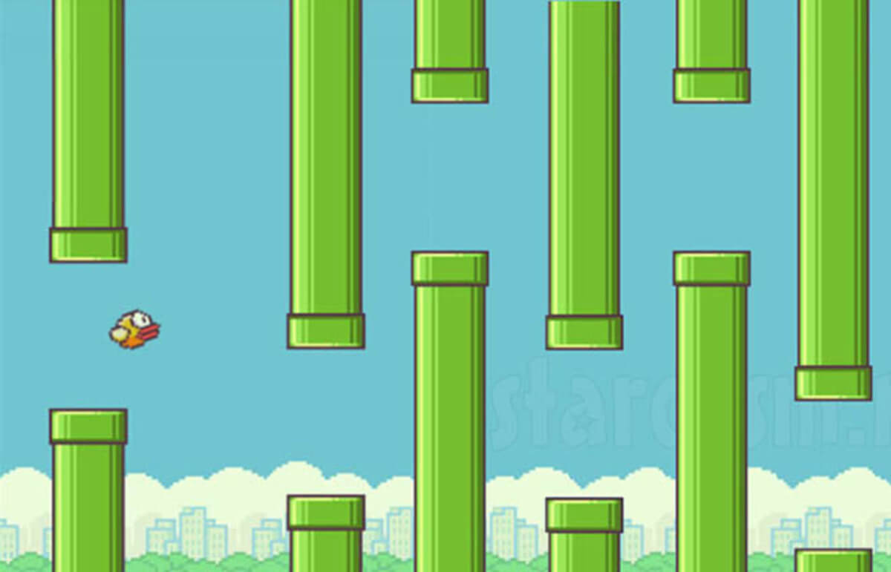
How to design a good game?
Like Flappy Bird!
What the player can do: tap the screen (only 1 action)
What’s difficult: very hard to time correctly.
Punchline: easy to learn, but hard to master.

Slide 8
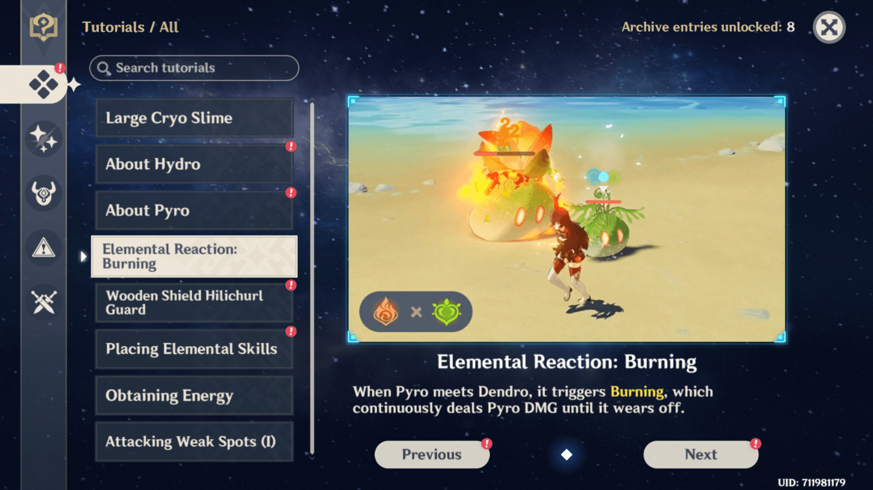
How to design a good game?
What if my game mechanism is inherently complicated?
The player should “learn” the mechanism gradually.
Tutorial levels: Explicit textual instructions given by the game.
May be embedded in an actual level, but the game still tells you what to do.
Notes:
Introduce the concept of an “ante-piece” first room introduce how the mechanics work. want meaningful reward - segues into next part

Slide 9
How to design a good game?
The problem with tutorial levels:
Players don’t learn by reading text. They learn by interacting!
“Show, don’t tell.”
Antepiece: an innocuous task that precedes a big challenge, that hints you at how you could tackle the big challenge.
No explicit verbal instructions, player should figure things out.
Example: Portal 2
Player can place two connecting portals to transport themselves.
Need to use portals to overcome obstacles.
Notes:
Introduce the concept of an “ante-piece” first room introduce how the mechanics work. want meaningful reward - segues into next part

Slide 10
How to design a good game?
Can’t jump onto the platform!
The orange portal is already created for you.
If you place a blue portal on the wall, you’ll come out of the orange portal.
This gives you enough velocity to reach the higher platform!
Idea: A forward movement, out of a portal, across a gap, to a place you couldn't reach.
A heuristic: “If you see a thrust-forward panel with an orange portal on it, try the trick you did in this level.”
Notes:
Introduce the concept of an “ante-piece” first room introduce how the mechanics work. want meaningful reward - segues into next part

Slide 11
How to design a good game?
Now, the real puzzle.
The player is likely to fall in the pit.
They have to get out by a floor portal.
This sets them up for the solution.
Recall previous level:
“If you see a protruding panel with a portal, falling into another portal will thrust you out from there”
Player will now try to jump into the blue portal intentionally.
They’ll get thrusted to the other side!
Notes:
Introduce the concept of an “ante-piece” first room introduce how the mechanics work. want meaningful reward - segues into next part

Slide 12
How to design a good game?
Antepiece helps player learn… but why would the player want to learn?
The player needs motivation to learn game mechanics.
Hence we also need feedback.
Positive feedback: when the player does well, they gain items, abilities, etc. so that the game becomes easier (and vice versa).
Reason: Players should be rewarded for doing well.
Ex. In most multiplayer combat games, the more opponents a player defeat, the more gold they get, and they can purchase more items.
What are some problems if positive feedback is too strong in a game?
Notes:
positive feedback more for competitive games, negative feedback more for party games

Slide 13
How to design a good game?
If positive feedback is too strong: players who are behind are very hard to catch up. A lot of focus on early-game decisions. Hence:
Negative feedback: when the player does well, the game becomes harder, by giving them more challenging levels/worse items, etc. (and vice versa)
Reason: Players should not fall too far behind. Things are more interesting if a lot of people are competing in the middle.
Ex. In some racing games, the last place player has higher chance get powerful boosts and weapons to knock out leading players.
What are some problems if negative feedback is too strong in a game?
Notes:
positive feedback more for competitive games, negative feedback more for party games

Slide 14
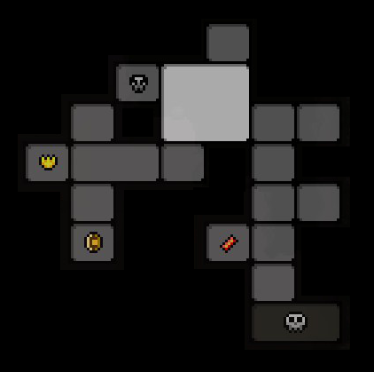

How to design a good game?
And speaking of motivation, there’s one other problem: player knows everything after a successful run, so the game becomes boring.
Hence, you need variability of game experience
You can “randomize” each run by randomizing items, rooms, etc.
Or you could just keep adding new content.
Notes:
One other problem - once you played through it once, knows everything about the game. follows the exact same; Flappy Bird died down quick because game is too predictable; With rogue-like games you can lose because you are too unlucky, the strategy is to increase your likelihood of winning. If not rogue-like, can add new content, or add randomness

Slide 15
Interactive Question
What elements would you add to BYOW to make it a good game?
Storyline - Immersion
Enemies / Obstacles
Something the player needs to overcome
Point System
Goal = maximize score?
Currency instead of points?

Slide 16
The Game Development Pipeline
Game Development
Designing a Good Game
The Game Development Pipeline
Programmer Perspective
Game Modding
Lecture 37, CS61B, Spring 2024
Notes:
Plan to be here around the 15 min mark (~:25 pm)

Slide 17
The pipeline for making a game
Say you designed some good game mechanics. How do you actually turn it into the final product?
You need to work with people on your team:
Designers
High level idea, level-design, plot, etc.
Artists / Musicians
Animations, sprites, music, sound effects (SFX)
Programmers
Code everything up
Testers
Find glitches in the game

Slide 18
The pipeline for making a game
The general process is:
You start with an idea.
Then you create paper-prototypes.
Then you create a Minimum Viable Product (MVP).
You iteratively improve your game, going through alpha -> beta -> release.
We’ll take Minecraft as an example.

Slide 19
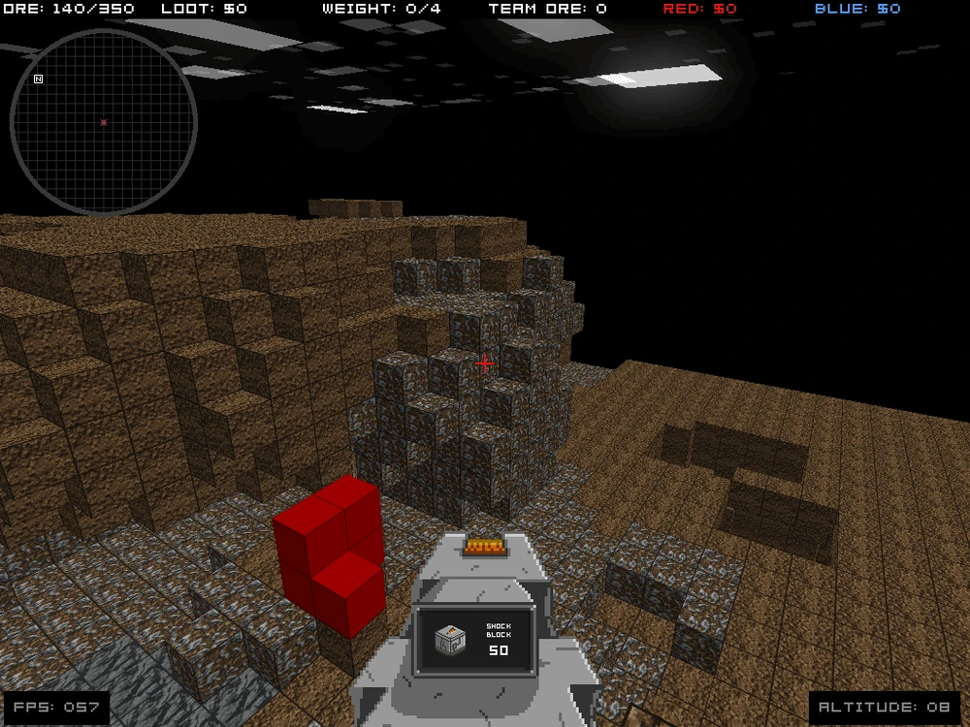
The pipeline for making a game - Idea
The ideation phase is a couple sentences or elements relevant to the game.
For Minecraft, this includes:
A block-based world.
Creativity (the player can do whatever they want in the world).
Randomly generated worlds.

Slide 20
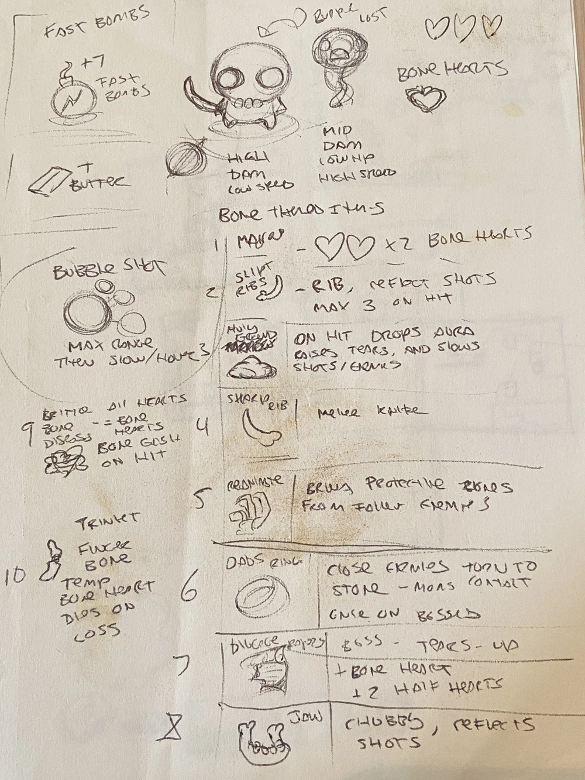
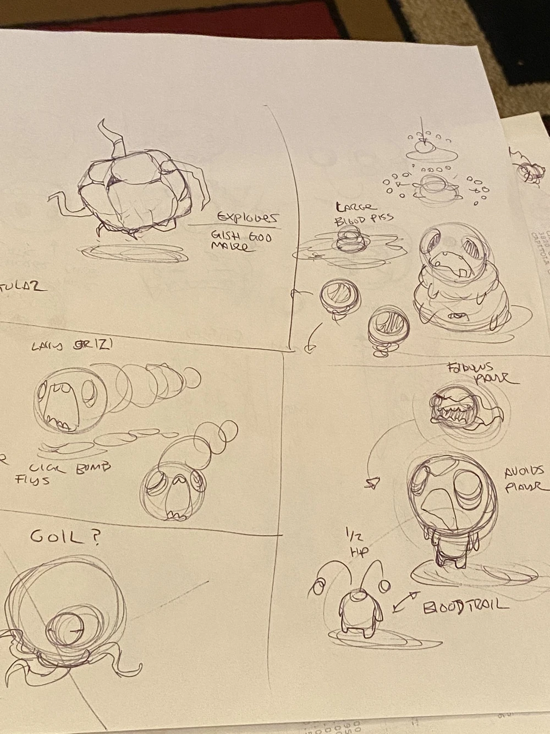
The pipeline for making a game - Paper Prototype
A paper prototype describes the game on paper.
The purpose: discuss, develop, and revise the details of the game internally without the need to write code.
Couldn’t find Minecraft paper prototype images, but here’s a sample paper prototype for the game Binding of Isaac.
Notes:
might want to discuss paper prototyping briefly here.

Slide 21
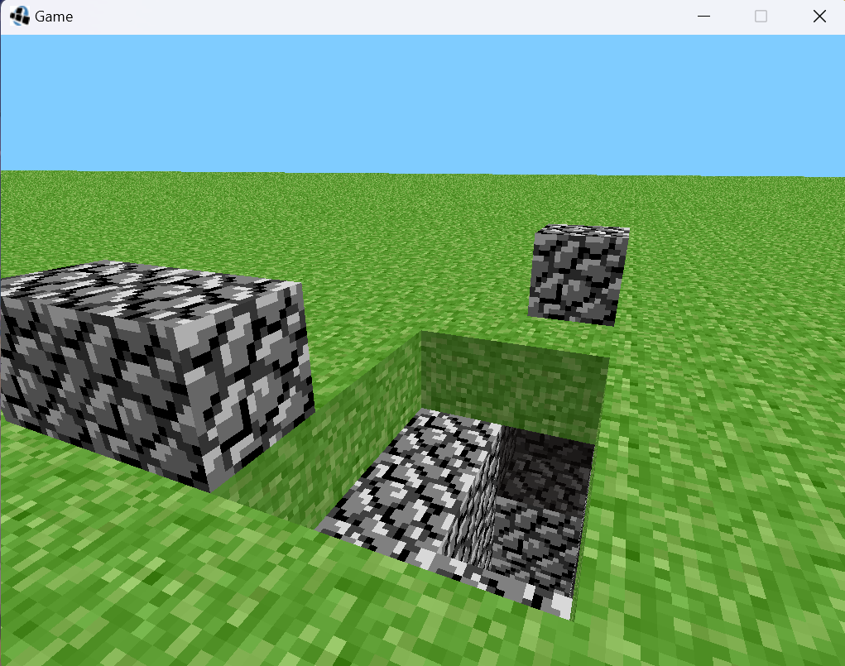
MVP (May 13 - 17, 2009)
Minimum Viable Product: a bare-bones but playable version of the game.
The purpose is to show “Hey, this idea works, I’ve implemented it in code!”
For Minecraft: No monsters, no health, only grass blocks and cobblestone.
WASD move around, Left click to place blocks, right click to destroy.
Your BYOW would most likely top up at this stage.
Notes:
White slides: might be useful if you do game dev in the future
Blue slides: more relevant to BYOW and mention in the beginning

Slide 22
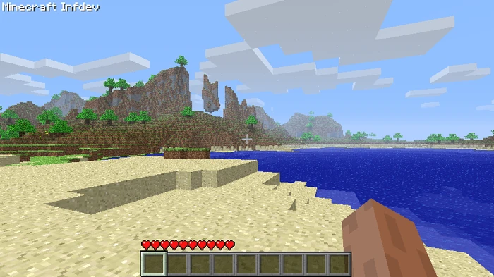
Alpha (May 2009 - Dec 2010)
The purpose of this stage is to show the game to a larger audience than the developers, including friends and other people you don’t know.
For Minecraft, this is when we have nether, multiplayer, fishing, etc.
Still missing a lot of features from modern MC: notice no hunger bar below!
Notes:
First show it to other people - get other friends, people you don’t know to play it.

Slide 23
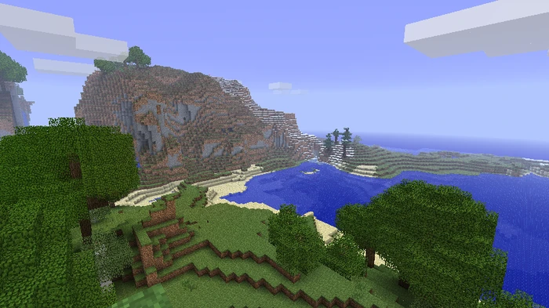
Beta (May 2010 - Nov 2011)
The purpose of this game is a preliminary release to the public.
For Minecraft, we now have both creative mode and survival mode.
We have different weather, more biomes, and a hunger bar.
Notes:
Releasing to the public (you get feedback, you go to Discord etc.)

Slide 24
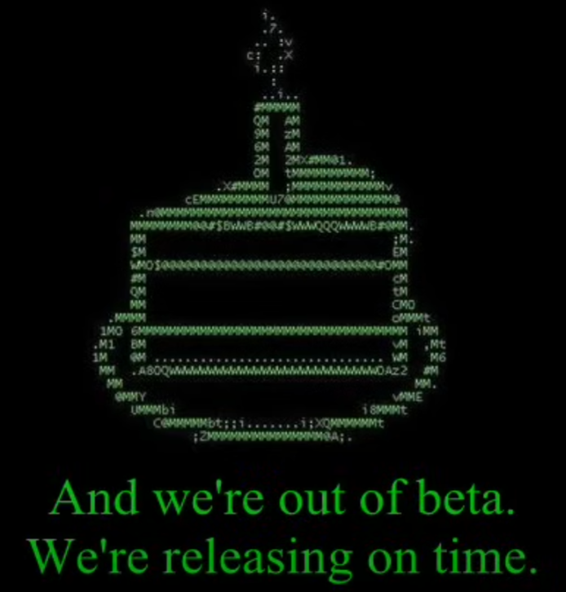
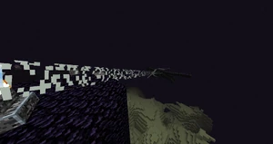
Full Release (Nov 18, 2011)
At some point, you declare that the game is polished enough to be official.
The cutoff between beta and release can be blurry.
For MC, this is when you can defeat the Ender Dragon and “beat the game”!
Notes:
this “Enderdragon” part is specific to Minecraft When you make your game, you get do decide when you go to full release (no clear distinction between Beta and Official? maybe when developer decides they want to announce)

Slide 25
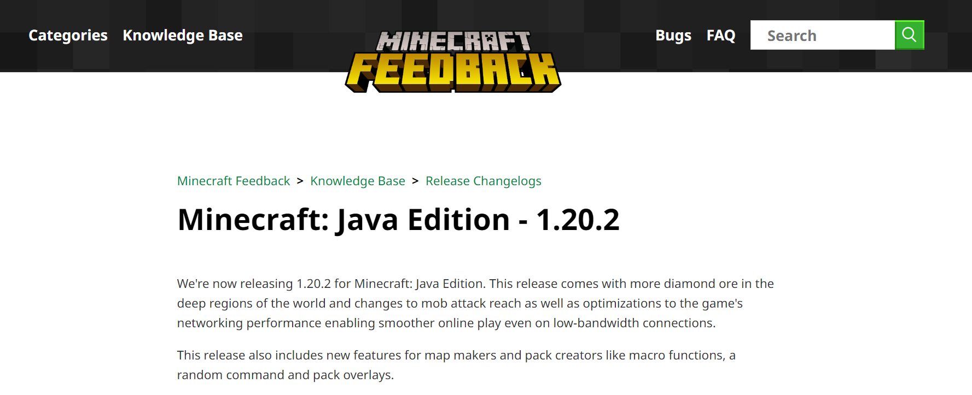
After final release
The game is still under development even after the official release.
Developers polish the game, patch bugs, and gather user feedback.
Minecraft receives version updates every now and then, when I started playing it was 1.4.7, now it is 1.20.2 (and it keeps going!).
Contents like shulker boxes, netherites added in.

Slide 26
Programmer Perspective
Game Development
Designing a Good Game
The Game Development Pipeline
Programmer Perspective
Game Modding
Lecture 37, CS61B, Spring 2024
Notes:
Aim to be here at around :30

Slide 27
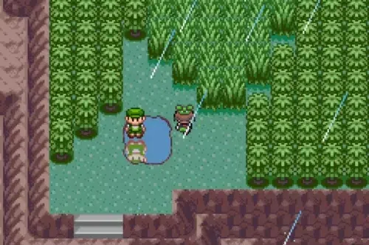
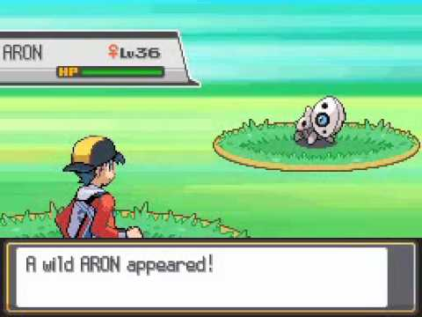
Coding up games from scratch
We’ve talked about how games are made in general, but now we want to dive into how to code in games.
The problem: design a version of BYOW with encounters, similar to encounter systems in Pokemon.
Notes:
put up some pokemon pictures (up to gen 6), one for world, one for encounter, give students a better idea.

Slide 28
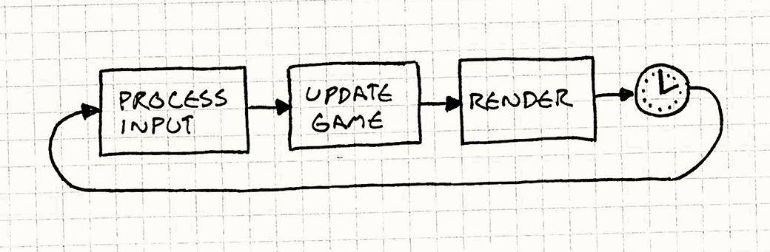
Coding up games from scratch
Let’s revisit how the basic BYOW works:
In a while loop, you would:
Process user input (Checks for W, A, S, D)
Update the game universe (Move avatars)
Render the current state to the user (Calls ter.renderFrame(tiles);)
You also wait for a bit until it is time to render the next frame.
Image Credit: gameprogrammingpatterns.com

Slide 29
Coding up games from scratch - keeping the code clean
In our BYoW with encounters: there exists different scenes.
Start at the main menu.
Press N -> “enter seed” scene.
Press S -> “world” scene.
“Encounter” scene.
The Problem: Each scene will have different things to “update”.
If you are in the “world” scene, you render blocks and process WASD.
If you are in the “encounter” scene, you don’t want to render world tiles, but you render information pertinent to the encounter.

Slide 30
Coding up games from scratch - keeping the code clean
Our goals:
Make game loop do different things in different scenes correctly.
Adding any new scene should be relatively easy.
Code structure should be as “neat” as possible.
Why? You will hate your past self if you don’t.
How can we do this?
Notes:
keep distinction with “stage”

Slide 31
Coding up games from scratch - keeping the code clean
Here’s something that we don’t want:
while (true) {
// title screen
char k = … //some method that gets the next key typed
if (k == ‘N’) {
// enter seed
while (true) {
k = … //gets the next key typed
if (k == ‘S’) {
// world movement
while (true) {
if (k == ‘W’) {
} else …
}
}
}
}
}
Notes:
another issue with this approach: impossible to transition between different stages

Slide 32
Coding up games from scratch - keeping the code clean
The issue: each new scene requires a new nested while (true)!
Also, impossible to switch back and forth between three scenes!
while (true) {
// title screen
char k = … //some method that gets the next key typed
if (k == ‘N’) {
// enter seed
while (true) {
k = … //gets the next key typed
if (k == ‘S’) {
// world movement
while (true) {
if (k == ‘W’) {
} else …
}
}
}
}
}
Notes:
note: this is impossible to transition between 3 states back and forth

Slide 33
Coding up games from scratch - keeping the code clean
Here’s a better approach, but can still be improved:
// Represents current scene
private String current;
public void gameLoop() {
while (true) {
if (current.equals(“title”)) {
} else if (current.equals(“enterSeed”)) {
} else if (current.equals(“world”)) {
} else if (current.equals(“encounter”) {
} else if (current.equals(“gameOver”) {
}
}
}

Slide 34
Coding up games from scratch - keeping the code clean
Issues: game loop becomes longer with added scenes, hurts readability.
// Represents current scene
private String current;
public void gameLoop() {
while (true) {
if (current.equals(“title”)) {
} else if (current.equals(“enterSeed”)) {
} else if (current.equals(“world”)) {
} else if (current.equals(“encounter”) {
} else if (current.equals(“gameOver”) {
}
}
}

Slide 35
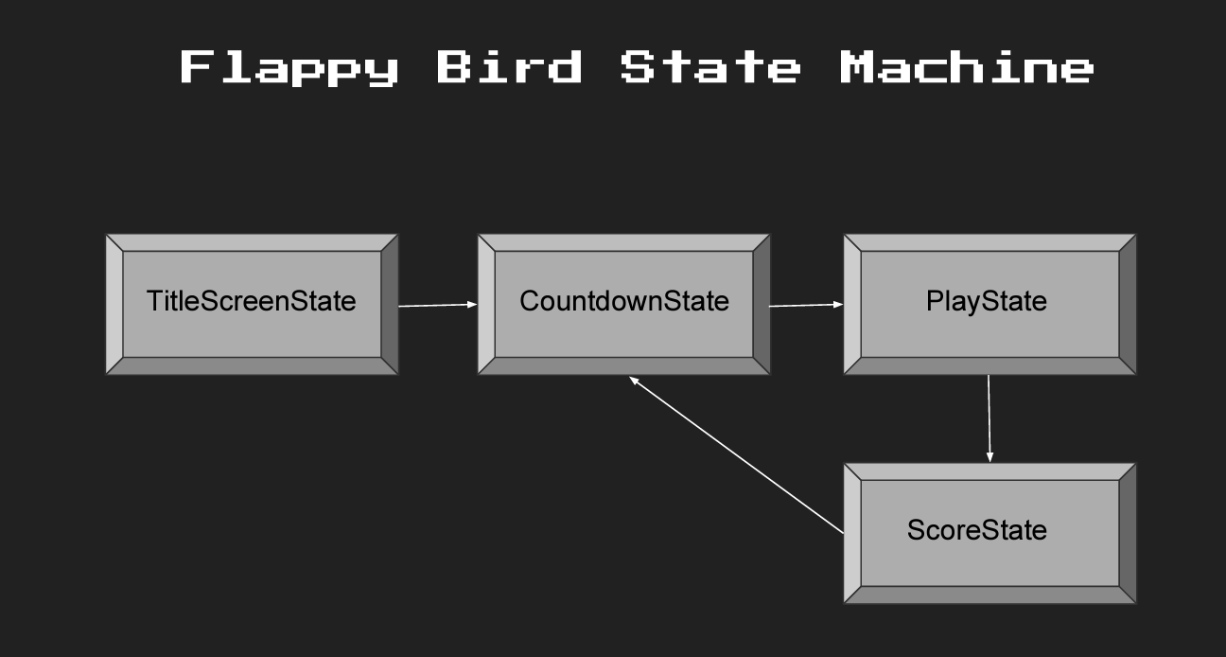
Coding up games from scratch - keeping the code clean
We’ll introduce the idea of a “finite state machine” to manage complex games with a lot of different scenes.
Notes:
insert flappy bird video but not strictly necessary

Slide 36
Coding up games from scratch - keeping the code clean
A finite state machine is a lot like a directed graph:
We have states that the machine can be in as “nodes”.
For instance, you will have Title, EnterSeed, World, Encounter, etc.
We have transitions from one state to another as “edges”.
For instance, if you are in state “Title” and pushes L, you should go to state “World”. This corresponds to an edge from “Title” to “World”.
The machine can only be in one state at a time.
Need a variable to keep track - this is extra from a directed graph!
A sequence of inputs or events is sent to the machine.
You check if any outgoing edges from your current state have their transition conditions fulfilled.
Notes:
connect with directed graphs: nodes are states, edges are the transitions, and you have a current stage.

Slide 37
Coding up games from scratch - keeping the code clean
Here’s how BYoW could potentially be modeled by:
This assumes you decide to do “win/lose”, restart game without closing.
GameWin
Restart
User collects coins
User steps on “coin door”
N
S
Title
EnterSeed
World
Encounter
Restart
Time runs out
L
:Q
GameOver
Q
Exit Game

Slide 38
Coding up games from scratch - keeping the code clean
Here’s how you could implement an FSM in code:
// Represents current state
private StateMachine stateMachine;
public void gameLoop() {
stateMachine = new StateMachine();
while (true) {
Set<Character> pressed = readInput();
stateMachine.update(pressed);
stateMachine.render();
}
}
public class StateMachine {
private HashMap<String, GameState> gameStates;
public StateMachine() { /* Initialize “GameState”s */ }
private String curr = “title”;
public void update(Set<Character> pressed) {
gameStates.get(curr).update(pressed);
}
public void render() { gameStates.get(curr).render(); }
public void changeState(String to) {
// Throw errors if to is not valid
gameStates.get(curr).exit();
gameStates.get(to).enter();
}
}
interface GameState {
StateMachine mach; // the FSM I belong to
void update(Set<Character> pressed);
void render(), enter(), exit();
}

Slide 39
Coding up games from scratch - keeping the code clean
And we can add new scenes as states…
// Represents current state
private StateMachine stateMachine;
public void gameLoop() {
stateMachine = new StateMachine();
while (true) {
Set<Character> pressed = readInput();
stateMachine.update(pressed);
stateMachine.render();
}
}
// Each class in a separate file
interface GameState {
StateMachine mach; // the FSM I belong to
void update(Set<Character> pressed);
void render(), enter(), exit();
}
public class WorldState implements GameState {
public void update(Set<Character> pressed) {
// Moves avatar based on “pressed”
if (stepOnDoor())
mach.changeState(“encounter”);
}
public void render() { /* draws the world */ }
}
public class EncounterState implements GameState {
public void update(Set<Character> pressed) {
// Moves avatar based on “pressed”
if (wonEncounter())
mach.changeState(“world”);
}
public void render() { /* draws objects in encounter */} }
By using FSMs, get a much cleaner main game loop!
To add a new state, extend from GameState.
Notes:
detail update should take in parameters of keyboard

Slide 40
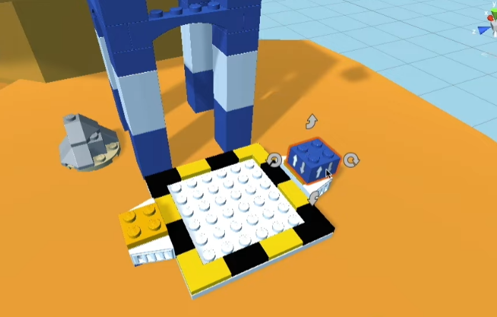
Game Engines Abstracts Away Details
Coding games from scratch is hard. Requires code that exists in most games.
Nowadays, people use game engines with all the boilerplate code built-in.
One example game engine is called Unity.
Unity is abstracted so well that you could develop games codelessly:
In Unity, every “thing” that exists in a game is a “game object”.
You can download game objects made by others from the Unity Store
Then drag and drop game objects in the Unity Editor!
When you attach this blue block to the platform, it will enable the platform to move up and down periodically.
The code that does this is already written for you!

Slide 41
Of course, you can still write code
Even if you decide to write code, the engine still abstracts a lot away for you.
In BYOW, need to come up with class definitions for Java classes.
But in Unity, you attach a “Script Component” to a game object that you want to control using code.
The script should inherit from a class called MonoBehaviour, and it should override these methods:
void Start() // Called before the first frame update
void Update() // Called for every frame update
The engine calls these methods behind the scenes for you.
What about scene transition?
Unity has an FSM running behind the scenes!
Notes:
connect more to the previous section “if you want unity to do this… it does it for you”, when you work with Unity, define what types of objects you want.

Slide 42
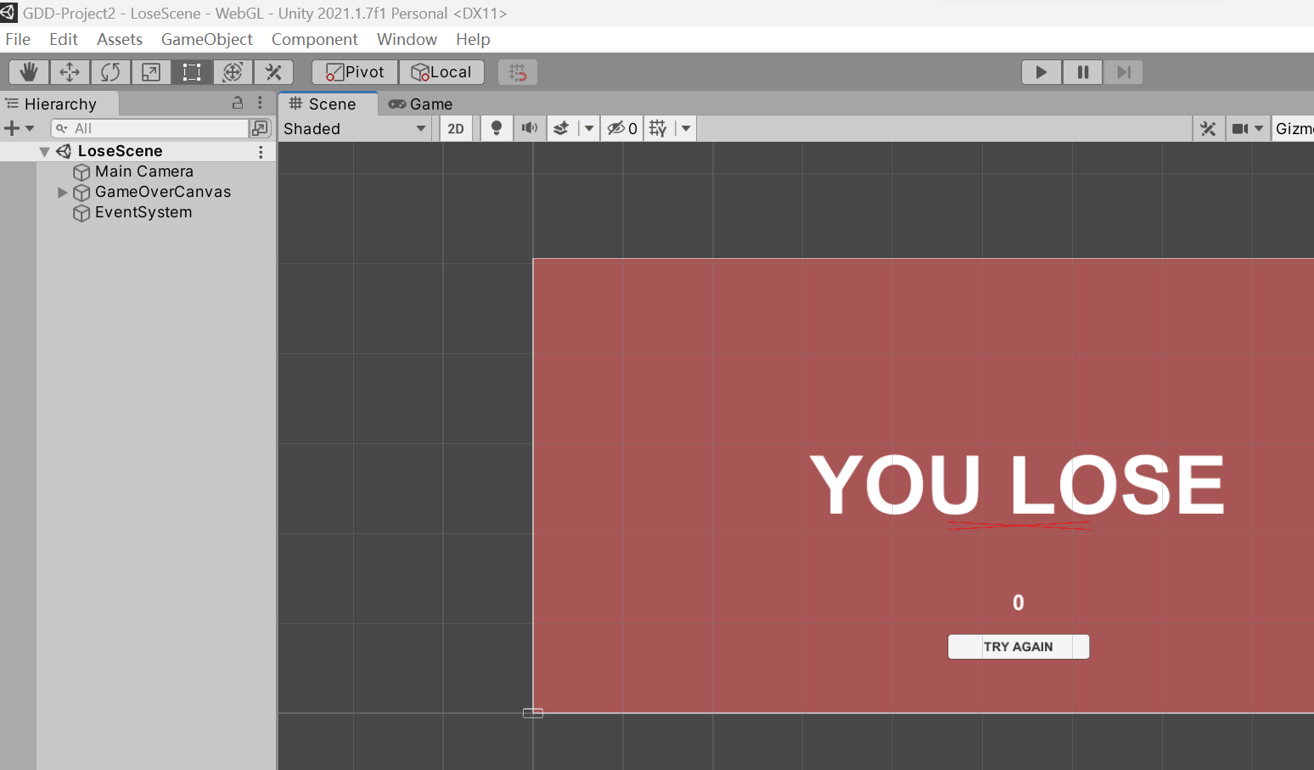
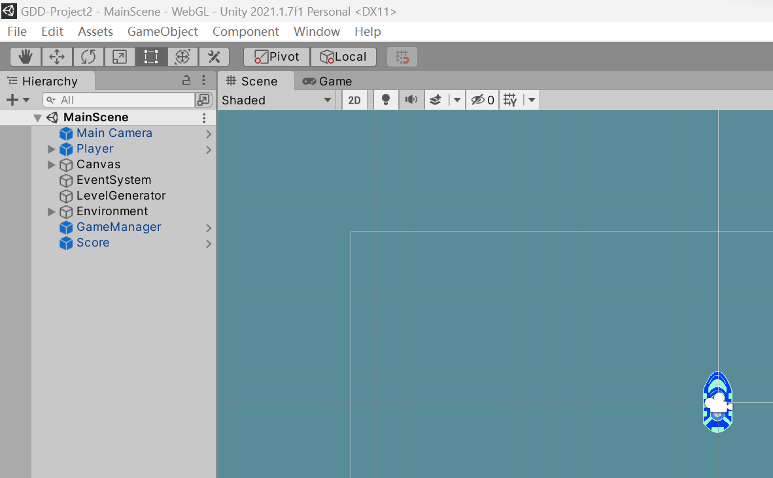
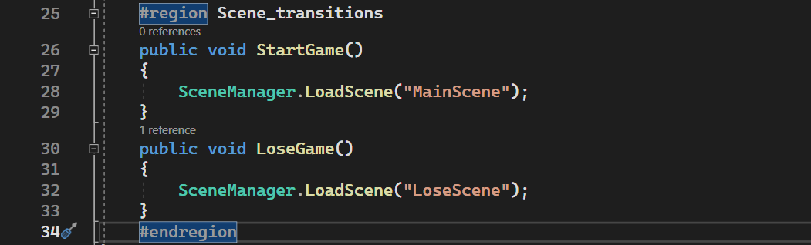
Why Unity is simpler - Scene Transition
In the Unity Editor, you can click on “File -> New Scene” to create a new scene for your game.
You can define what game objects need to exist in that scene, and what they should do when the scene starts.
When you want to transition between scenes, you just call SceneManager.LoadScene(“another scene”)!

Slide 43
But still, the ability to write good code matters…
DRY (Don’t Repeat Yourself)
If you make different variants of an enemy, consider use inheritance.
e.g., green, blue, and purple slimes are all slimes, with different stats.
Separate “data” from “logic”
Store enemy stats in a separate text file and load it.
Hardcoding is OK for small games, but bad for large games..
Learn to work with different types of assets (resources used in games)
Images, audio, and 3D models.
Need to know some algorithms
For instance, A* path finding for enemies.
And finally, DRY (Don’t Repeat Yourself)
Notes:
“e.g., if you make enemies, don’t make multiple of them, just make one

Slide 44
Game Modding
Game Development
Designing a Good Game
The Game Development Pipeline
Programmer Perspective
Game Modding
Lecture 37, CS61B, Spring 2024
Notes:
Be here at around :48

Slide 45
Game Modding
Let’s say you don’t want the trouble of creating an entirely new game, but just want to work off an existing game.
This is called game modding.
“Mod” is short for “modify”.
What is a “mod”?
An add-on to an existing game that provides new gameplay elements or modifies existing gameplay experience.
Notes:
All sorts of fan-based modding communities (osu!, super mario world), you don’t want to make the levels so just let the players make the levels! A lot of modders -> mario maker setup connections to the real world

Slide 46
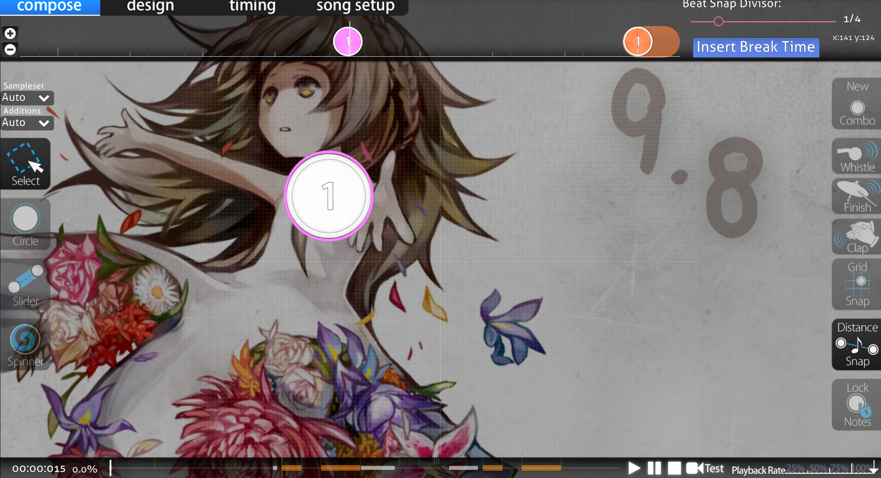
Game Modding - Adding new content
One way to mod games is to add new levels.
For instance, osu!, a music game, allows creating custom levels via drag and drop. You can add songs as you wish.
Super Mario games also have a lot of player-made level editors.

Slide 47
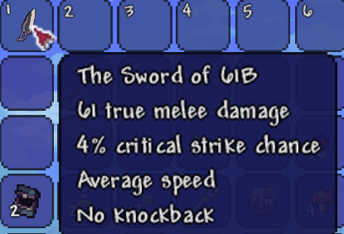
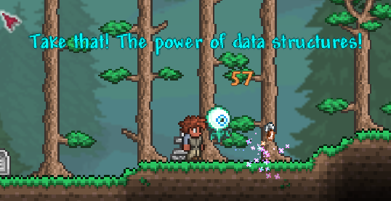
Game Modding - Adding new content
You can also choose to add new content using code (shown is Terraria modding). This would require reading tutorials and documentation.
public class Sword61B extends ModItem {
@Override
public void setDefaults() {
item.damage = 61;
item.damageType = DamageClass.MELEE;
// Other logic
}
@Override
public void OnHitNPC(Player player, NPC target, NPC.HitInfo hit, int damageDone) {
Main.NewText(“Take that! The power of Data Structures!”);
}
}

Slide 48
Game Modding - Is it legit?
In the old days, a lot of games don’t have official modding support.
Minecraft and Terraria didn’t originally officially support mods.
But people in the community “reverse-engineer” games secretly and created mod support platforms for people to build mods.
Technically modding is grey-area, but the game companies realized that mods actually help with popularity of game and retain users.
Eventually modding became (semi-)officially supported.
Bottom lines: never release the source code of the vanilla game!
Do not mod a game if the developer explicitly bans it.
For some games, official mod support is provided from the start.
Examples are Binding of Isaac; Don’t Starve Together
Notes:
“some of you might be thinking, is this legal, is this allowed?”

Slide 49
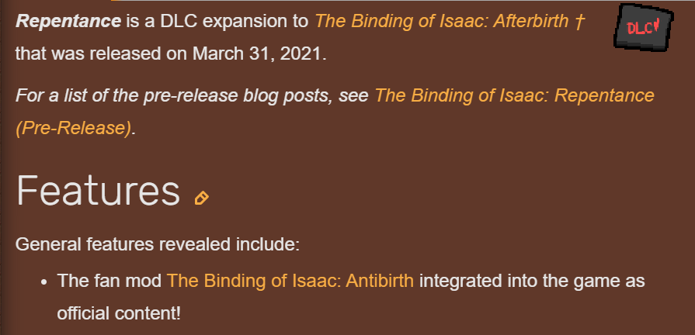
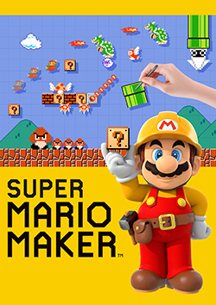
Game Modding - How does modding affect the game itself?
Game developers take away from good mods
Example: Binding of Isaac Repentance update - draw a lot of content from Binding of Isaac Antibirth. It was the largest mod for Binding of Isaac at that time yet.
Another example: Super Mario Maker
A lot of players creating own levels - why not create a game about that?

Slide 50
Summary
Coming up with good game ideas.
Easy to learn, hard to master; Antepiece; Feedback; Variability
The pipeline of making a game.
Idea, Paper Prototype, MVP, Alpha, Beta, Release
Writing code for games
Using pure Java - why FSM is good
Using Unity - why game engines are good
Modding an existing game.
At each layer, you lose some freedom, but do less “dirty work”.
But, you can choose whatever layer you enjoy the most when you develop an indie game - you’re not constrained by deadlines or company goals.
Therefore, I hope you find this lecture and indie game development fun and would consider developing this as a hobby.

Slide 51
Q&A
Notes:
Be here at around :55

